Slide 1
C++ PROJECT Expense tracker
Submitted To : Naveen Kumar Reddy
Submitted by : Vanshika Goyal (2210990946),
Vaani (2210990930)
Group:G-31(2nd year)
Chitkara University Institute of Engineering and Technology, Chitkara University, Punjab

Slide 2
Table of Contents
Abstract
Introduction
Existing system & Drawbacks
Proposed System & Advantages
Architecture design
Code snippet& screenshots
Conclusion & References

Slide 3
Abstract
The goal of the cost Tracker project is to provide effective and systematic personal cost management through the development of a full C++ application. Expense and Expense Tracker are the two primary classes of the project, which makes use of object-oriented programming concepts. The type, description, and amount of each expense are all contained in the Expense class. Concurrently, the Expense Tracker class makes it easier to combine and work with spending information.
The menu-driven architecture of this program makes it easier to use and more accessible. It also provides an intuitive interface. The program allows users to interact with it in an easy way to complete important tasks including entering new expenses, displaying existing expenses, and figuring out the overall amount spent. Efficient handling of input and unambiguous prompts are included to enhance the user experience.
An overview of the project's design, operation, and instructional value is given in this abstract, which also highlights the project's applicability and significance in personal money management.

Slide 4
Introduction
The Expense Tracker project proves to be a useful resource for people who want to keep an organized and transparent record of their spending in a world where money management is crucial. Using just two core classes—Expense and Expense Tracker—this C++ application uses object-oriented programming in its purest form. The Expense Tracker class offers an organized framework for organizing and analyzing this expense data, while the Expense class captures the fundamental information about each expense, including category, description, and amount.
The growing need for a simple and effective way to keep track of personal finances is being addressed by this project. Users can easily navigate through the application to perform key actions like adding new expenses, displaying existing ones, and calculating the total amount incurred thanks to its user-friendly menu-driven interface. As we examine the Expense Tracker project's complexities, we'll also look at the reasons behind its creation, its salient characteristics, and how it serves as an example of how object-oriented concepts are used in real-world C++ programming.

Slide 5
Existing system
Before the Expense Tracker project was put into action, people frequently struggled with the task of manually keeping track of and organizing their expenses. Conventional approaches, like manual ledgers on paper or rudimentary spreadsheet programs, were inefficient and difficult to use for managing finances effectively. Lack of a systematic approach frequently led to oversight, incorrect calculations, and a lack of real-time spending pattern insights.
The goal of the Expense Tracker project is to overcome these constraints by implementing an automated and structured system. A C++ application that makes use of object-oriented principles to improve accessibility and organization replaces the current manual methods. Users can now input, retrieve, and analyze their expenses with ease using a menu-driven interface, making this a more efficient and error-proof method than the traditional ones. The efficiency and accuracy of managing personal finances has significantly improved with the transition from manual tracking to a digital, programmatic solution.

Slide 6
Drawbacks of Existing System
Error-Prone Manual Entry: Manual entry techniques that are based on tradition are prone to human error, which can result in inaccurate financial records.
Restricted Mobility and Accessibility: Spreadsheet-based or paper-based systems limit mobility and accessibility, which makes it difficult for users to manage spending while on the go or across multiple devices.
Lack of Automation and Efficiency: When the number of transactions rises, manual systems become less efficient and require a lot of time and effort for data entry and analysis.
Ineffective Data Analysis: In manual systems, it is difficult to derive significant insights from large amounts of data, which makes financial analyses less effective.
Scalability Challenges: Manual systems encounter scalability problems as transaction volumes increase, making it challenging to keep an orderly and transparent accounting of costs.
The Expense Tracker project addresses these limitations by offering an automated, user-friendly alternative for personal expense management.

Slide 7
Proposed System
Automated Data Entry: By automating spending tracking, the suggested system lowers the possibility of data entry errors made by humans.
Improved Accessibility: The new system provides easy access and management of expenses from multiple devices and locations, in contrast to traditional methods.
Effective Data Analysis: By utilizing object-oriented programming, the suggested system makes it simple to retrieve spending insights and create thorough reports.
The Expense Tracker project, as a proposed system, aims to provide users with a user-friendly, automated, and scalable solution for tracking and managing personal expenses, overcoming the drawbacks of manual methods.

Slide 8
Advantages of Proposed System
Error Reduction: The suggested system's automated data entry reduces the possibility of errors, guaranteeing accurate and trustworthy financial records.
Improved Accessibility: Users can easily track and manage their spending from a variety of devices, giving them flexibility and accessibility from anywhere at any time.
Time-Efficient Data Analysis: The suggested system makes effective use of object-oriented programming concepts to facilitate data analysis, allowing users to quickly derive insightful conclusions and produce thorough reports.
The Expense Tracker project's proposed system offers a range of advantages, providing users with a more efficient, accurate, and user-friendly solution for personal expense management.

Slide 9
Architecture /design
User Interface Module:
Main function acts as a user interface with a menu-driven system.
Users interact by choosing options for adding expenses, displaying them, calculating totals, or exiting the program.
Expense Class:
Represents individual expenses with attributes like category, description, and amount.
Ensures encapsulation and provides a display method for expense details.
Expense Tracker Class:
Manages Expense objects using a vector.
Includes methods for adding expenses, displaying them, and calculating the total.
Automated Data Entry:
Integrates automated data entry to minimize errors during expense input.
This architecture ensures a user-friendly, scalable, and organized Expense Tracker system, minimizing errors and facilitating efficient personal expense management.

Slide 10
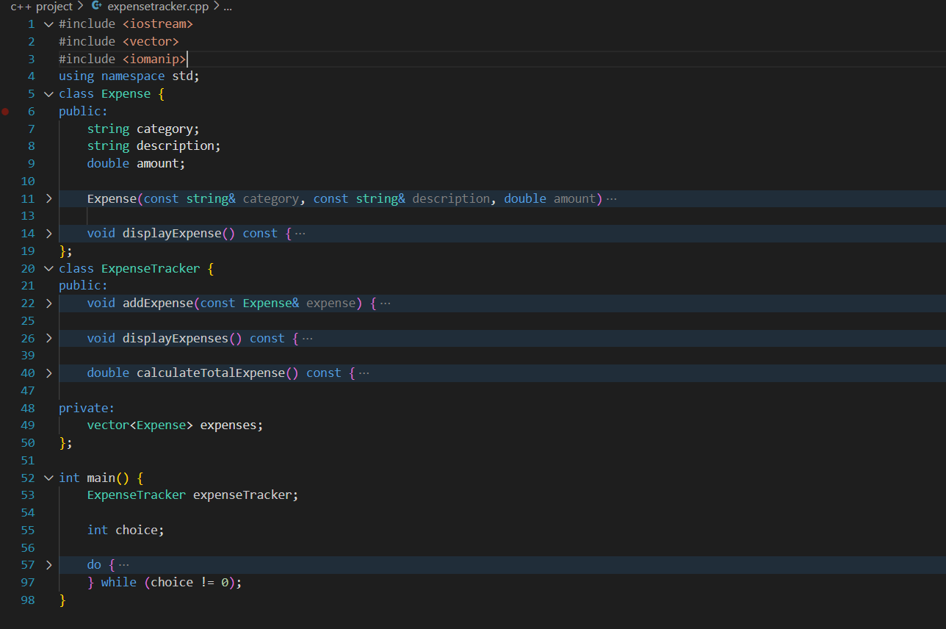
CODE SNIPPET

Slide 11
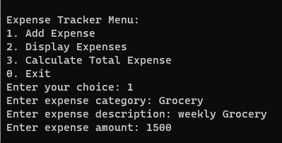
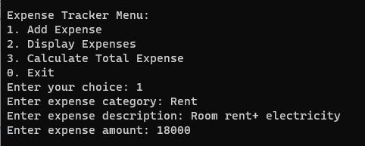
Test Cases
1)Adding Expense

Slide 12
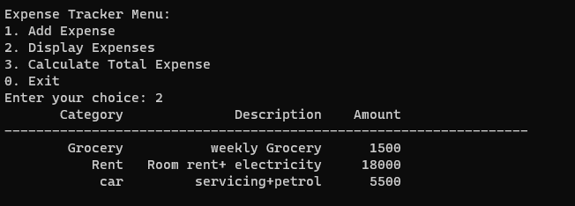
Test Cases
2)Displaying Expense

Slide 13
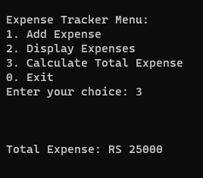
Test Cases
2)Calculate Total Expense

Slide 14
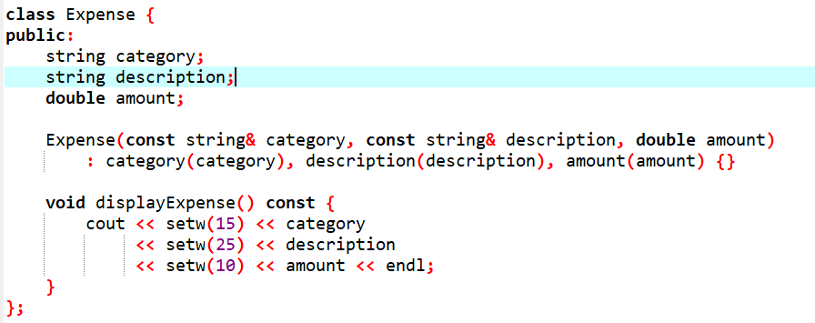
Screenshots

Slide 15
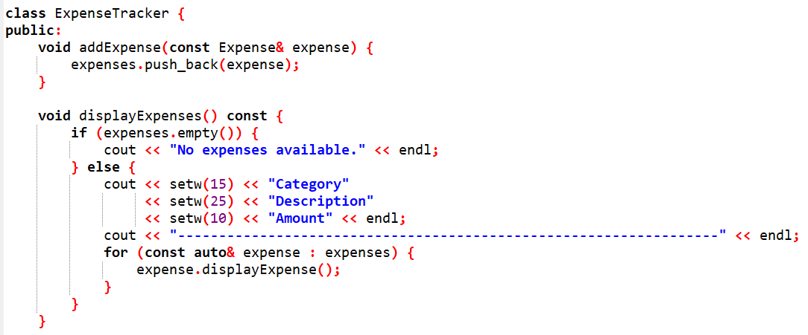
Screenshots

Slide 16
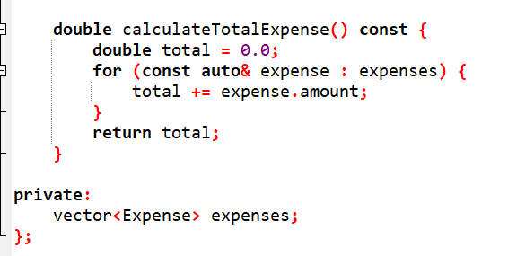
Screenshots

Slide 17
Conclusion & References
In conclusion, the Expense Tracker project provides a practical solution for efficient personal finance management. Through the implementation of a user-friendly C++ application, users can easily add, view, and analyze their expenses. The project demonstrates the effectiveness of C++ in creating streamlined console-based tools for everyday use.
The development of the Expense Tracker project drew inspiration from key references, including chatgpt, Stack Overflow, and various C++ programming books and tutorials. These resources played a pivotal role in shaping the project's structure, functionality, and adherence to best practices in C++ development.

Slide 18


